Slide 1
FIN 580 HW2 Presentation
Emanuel Scoullos
Yaojun Yu

Slide 2
Data Description & Cleaning
We assumed that a day starts from 4:05 pm and ends at 4:00 pm on the next calendar day. Thus, we assumed that the number of trading days in a year to be 252.
We assumed that a week starts from 4:05 pm on Sunday and ends at 4:00 pm on Friday. Thus, we assumed that the number of trading weeks in a year to be 52.

Slide 3
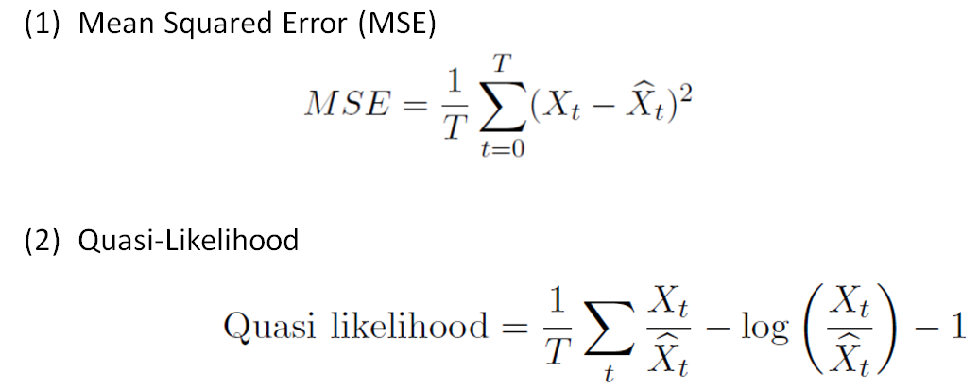
Performance Measurement

Slide 4
VAR (Vector Auto Regression)
General Methodology – VAR
Data used to fit
the first model
Data used to fit
the second model
The first
prediction
The second
prediction
T1
T1+1
T1+2
T2
T1 is the last datum in the first 3.5 years
T1+1 is the first datum in the last 1.5 years
T2 is the last datum in the test sample
First 1.5 Years
Last 1.5 Years

Slide 5
VAR (Vector Auto Regression)
We only implemented VAR on daily volatility data.
We first took log of annualized daily volatility to get log realized volatility (logRV) for model fitting and predication.
We divided the data into the first 3.5 years (until October 31st 2011) and the last 1.5 years (since November 1st 2011). The first prediction made was logRV on November 1st 2011.

Slide 6
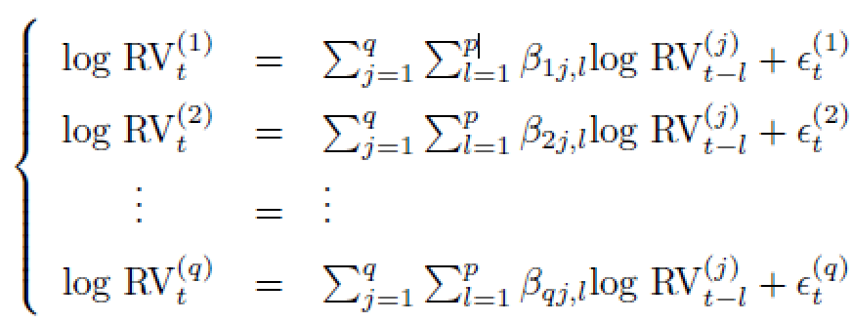
VAR (Vector Auto Regression)
Based on the q equations below, we first used p=1 to conduct linear regression analysis. Given our data, q=9.

Slide 7
VAR (Vector Auto Regression)
We used a growing window method to fit the model and make predictions. When calculating MSE and QL as well as obtaining the squared error (SE) plots, we took exponential to the both the observed and predicted logRV to calculate MSE and QL using the observed and predicted annualized volatilities for each of 9 currency pairs and obtain SE plots for each. We also calculated the average MSE and QL values to gain a better understanding about the model’s prediction performance.

Slide 8
VAR (Vector Auto Regression)
We repeated Step (5) for p=2 and p=3.
We then identified the p value that gave the best prediction performance.

Slide 9
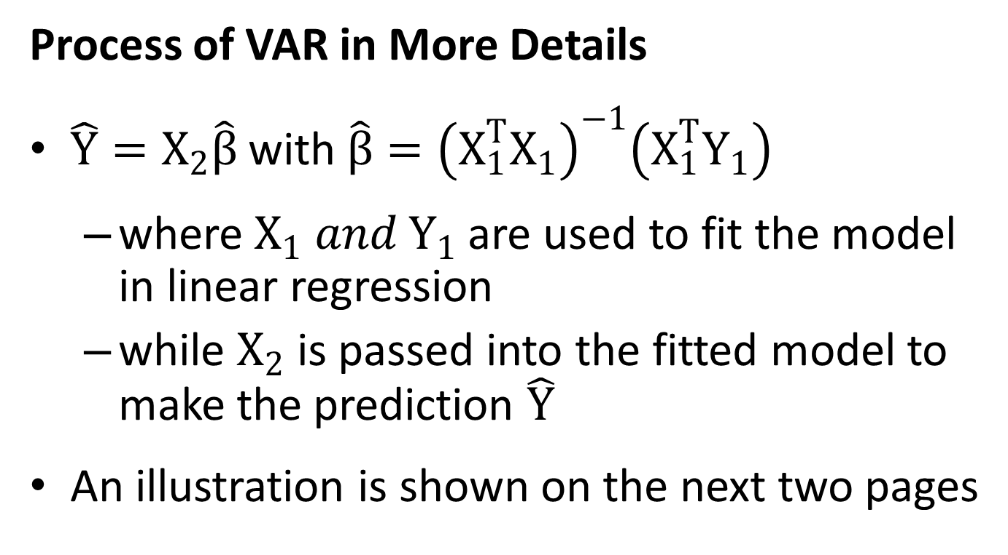
VAR (Vector Auto Regression)
Process of VAR in More Details
$\hat{Y}=X_{2}\hat{β}$with$\hat{β}={\left(X_{1}^{T}X_{1}\right)}^{−1}\left(X_{1}^{T}Y_{1}\right)$
where $X_{1} and Y_{1}$ are used to fit the model in linear regression
while $X_{2}$ is passed into the fitted model to make the prediction $\hat{Y}$
An illustration is shown on the next two pages

Slide 10
Currency Index
Time
Index
0
1
2
3
4
5
6
7
8
(0)
(1)
………………….…………………………..
(8)
t=p
Yp
logRVp
logRVp
logRVp
Data used to fit
the first model
t=p+1
Yp+1
(0)
(1)
………………….…………………………..
(8)
logRVp+1
logRVp+1
logRVp+1
Data used
to fit the
second model
…......…
…......…
…......…
…......…
…......…
…......…
…......…
Y
=
=
(0)
(1)
………………….…………………………..
(8)
t=T1
YT1
logRVT1
logRVT1
logRVT1
YT1+1
(0)
(1)
………………….…………………………..
(8)
Data used
to fit the
last model
t=T1+1
logRVT1+1
logRVT1+1
logRVT1+1
t=T1+2
YT1+2
(0)
(1)
………………….…………………………..
(8)
logRVT1+2
logRVT1+2
…...
…...
…...
logRVT1+2
…...
…...
…...
…...
t=T2-1
YT2-1
(0)
(1)
………………….…………………………..
(8)
logRVT2-1
logRVT2-1
logRVT2-1
YT2
(0)
(1)
………………….…………………………..
(8)
t=T2
logRVT2
logRVT2
logRVT2
The prediction
made by
the last
fitted model
The prediction
made by
the first
fitted model
The prediction made by
the second
fitted model

Slide 11
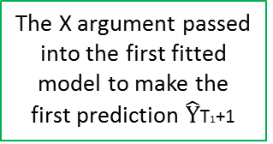
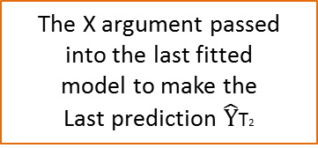
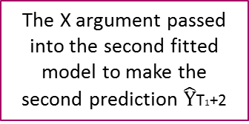
Currency Index
0
…………………………………..….………..
8
Time
Index
(0)
…
(0)
………………….………..
(8)
…
(0)
t=p
Xp-1
logRVp-1
logRV0
logRVp
logRV0
Data used to fit
the first model
(0)
(0)
………………….………..
(8)
(0)
t=p+1
Xp
logRVp+1
…
logRV1
logRVp+1
…
logRV1
…......…
…......…
…......…
Data used
to fit the
second model
…......…
…......…
…......…
…......…
X
=
=
(0)
…
(0)
………………….………..
(8)
…
(0)
t=T1
XT1-1
logRVT1-1
logRVT1-p
logRVT1
logRVT1-p
XT1
(0)
…
(0)
………………….………..
(8)
…
(0)
Data used
to fit the
last model
t=T1+1
logRVT1
logRVT1-p+1
logRVT1+1
logRVT1-p+1
t=T1+2
XT1+1
(0)
…
(0)
………………….………..
(8)
…
(0)
logRVT1+1
logRVT1-p+2
logRVT1+2
logRVT1-p+2
…...
…...
…...
…...
…...
…...
…...
(0)
…
(0)
………………….………..
(8)
…
(0)
t=T2-1
XT2-2
logRVT2-1
logRVT2-1
logRVT2-1
logRVT2-1
(0)
…
(0)
………………….………..
(8)
…
(0)
t=T2
XT2-1
logRVT2
logRVT2
logRVT2
logRVT2
The X argument passed into the first fitted
model to make the
first prediction $\hat{Y}$T1+1
The X argument passed into the second fitted
model to make the
second prediction $\hat{Y}$T1+2
The X argument passed into the last fitted
model to make the
Last prediction $\hat{Y}$T2

Slide 12
LASSO/Ordered LASSO
General Methodology - LASSO/Ordered LASSO
We only implemented LASSO/Ordered LASSO on daily volatility data.
We used logRV for model fitting and predication as we did in VAR.
We divided the data into the training sample (first 3.5 years until October 31st 2011) and the test sample (last 1.5 years since November 1st 2011).

Slide 13
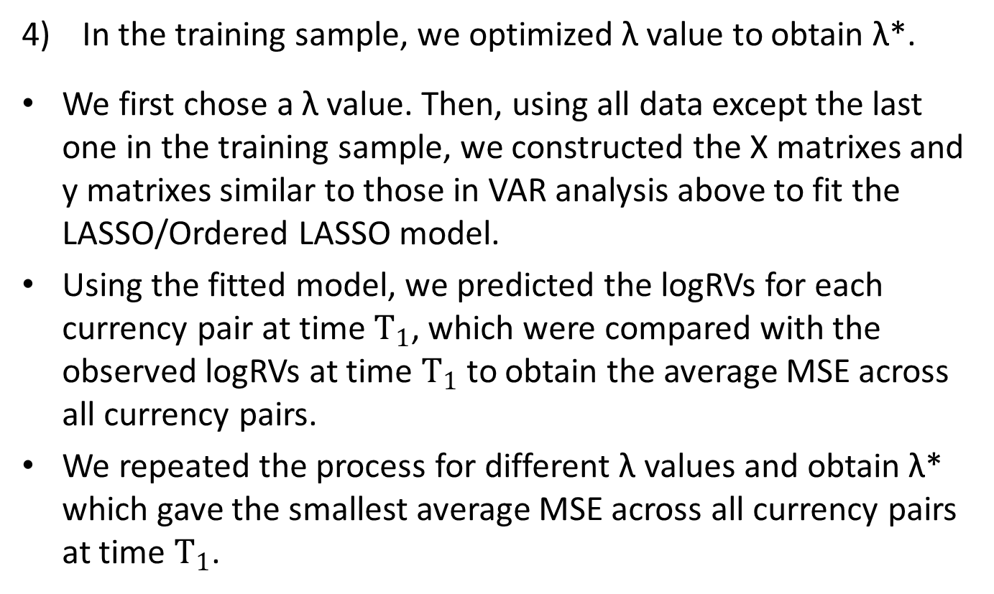
LASSO/Ordered LASSO
In the training sample, we optimized λ value to obtain λ*.
We first chose a λ value. Then, using all data except the last one in the training sample, we constructed the X matrixes and y matrixes similar to those in VAR analysis above to fit the LASSO/Ordered LASSO model.
Using the fitted model, we predicted the logRVs for each currency pair at time $T_{1}$, which were compared with the observed logRVs at time $T_{1}$ to obtain the average MSE across all currency pairs.
We repeated the process for different λ values and obtain λ* which gave the smallest average MSE across all currency pairs at time $T_{1}$.

Slide 14
LASSO/Ordered LASSO
We then used the LASSO/Ordered LASSO model with the optimal λ* we obtained from the training sample on the test sample to obtain MSE and QL as well as the SE plot, adopting the growing window method.

Slide 15
LASSO/Ordered LASSO
The LASSO was implemented using the penalized package in R.
The Ordered LASSO was implemented in R using orderedLasso package.
In both LASSO and Ordered LASSO, we utilized all columns of X matrix and each column of Y matrix in VAR as the model inputs to obtain fitted parameters.

Slide 16
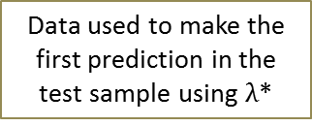
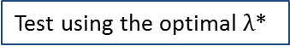
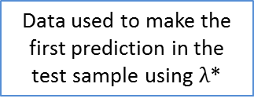
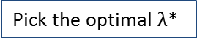
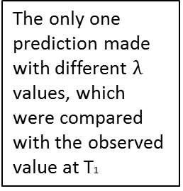
For LASSO / Ordered LASSO
The only one prediction made with different $λ$ values, which were compared with the observed value at T1
Data used to fit the model using $λ_{1}$ in the test sample
The first prediction
made in the
test sample
Data used to fit the model using $λ_{2}$ in the test sample
…
Data used to fit the model using $λ_{n}$ in the test sample
The second prediction
made in the
test sample
…
T1-1
T1
T1+1
T1+2
T2
Data used to make the
first prediction in the
test sample using $λ$*
Data used to make the
first prediction in the
test sample using $λ$*
Training Sample
(first 1.5 years)
Test Sample
(last 1.5 years)
Pick the optimal $λ$*
Test using the optimal $λ$*
T₁ is the last datum in the training sample
T₁+1 is the first datum in the test sample

Slide 17
KNN
General Methodology - KNN Regression
Data used to fit the
first model in the
training sample
The first prediction
made in the
training sample
Data used to fit the
first model in the
test sample
The first prediction
made in the
test sample
100
101
T1
T1+1
T2
T₁ is the last datum in the training sample
T₁+1 is the first datum in the test sample
Skip the first 100 data
Training Sample
(first 3.5 years)
Test Sample
(last 1.5 years)
Pick the optimal k*
Test using the optimal k*

Slide 18
KNN
We divided the data into the training sample (first 3.5 years until October 31st 2011) and the test sample (last 1.5 years since November 1st 2011).
We used an expanding window (i.e., using all historical data) to find the k-nearest points.
Notice that since we applied KNN on a time series of annualized daily volatilities, we should not use the random sampling method which ignores the time information.

Slide 19
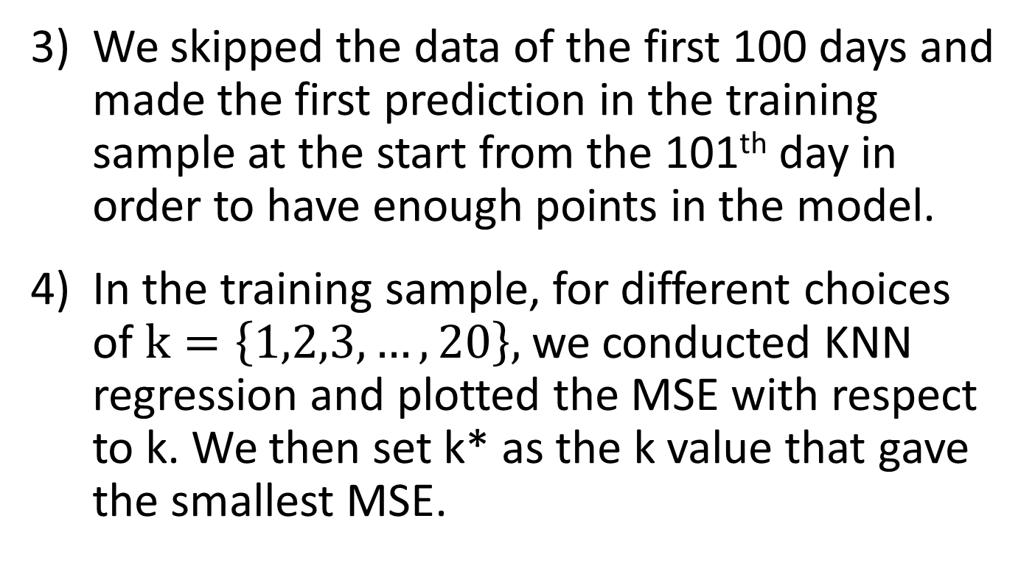
KNN
We skipped the data of the first 100 days and made the first prediction in the training sample at the start from the 101th day in order to have enough points in the model.
In the training sample, for different choices of $k=\left\{1,2,3,…,20\right\},$we conducted KNN regression and plotted the MSE with respect to k. We then set k* as the k value that gave the smallest MSE.

Slide 20
KNN
In the test sample, we used k* to conduct KNN regression, and measured prediction performance using MSE, QL and SE plot.

Slide 21
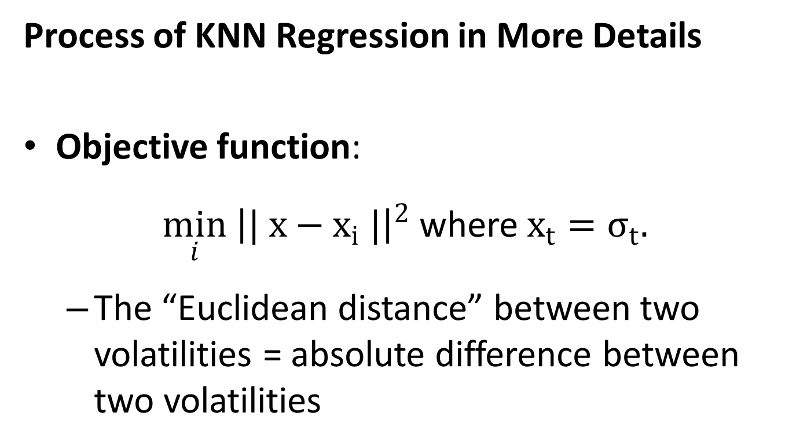
KNN
Process of KNN Regression in More Details
Objective function:
$\min_{i} {\left|| x−x_{i} |\right|}^{2}$ where $x_{t}=σ_{t}.$
The “Euclidean distance” between two volatilities = absolute difference between two volatilities

Slide 22
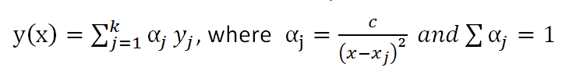
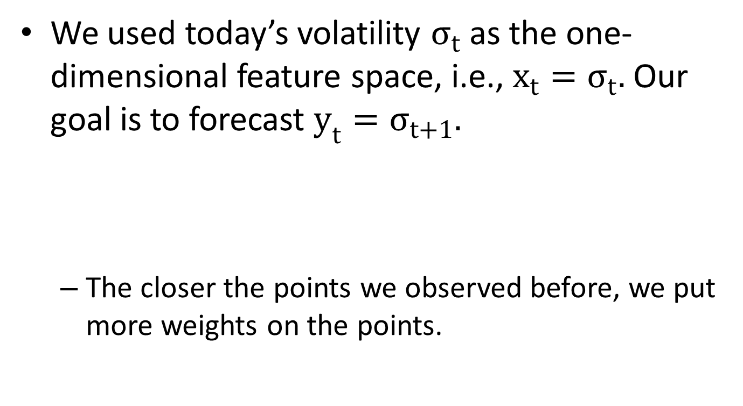
KNN
We used today’s volatility $σ_{t}$ as the one-dimensional feature space, i.e., $x_{t}=σ_{t}.$ Our goal is to forecast $y_{t}=σ_{t+1}.$
The closer the points we observed before, we put more weights on the points.

Slide 23
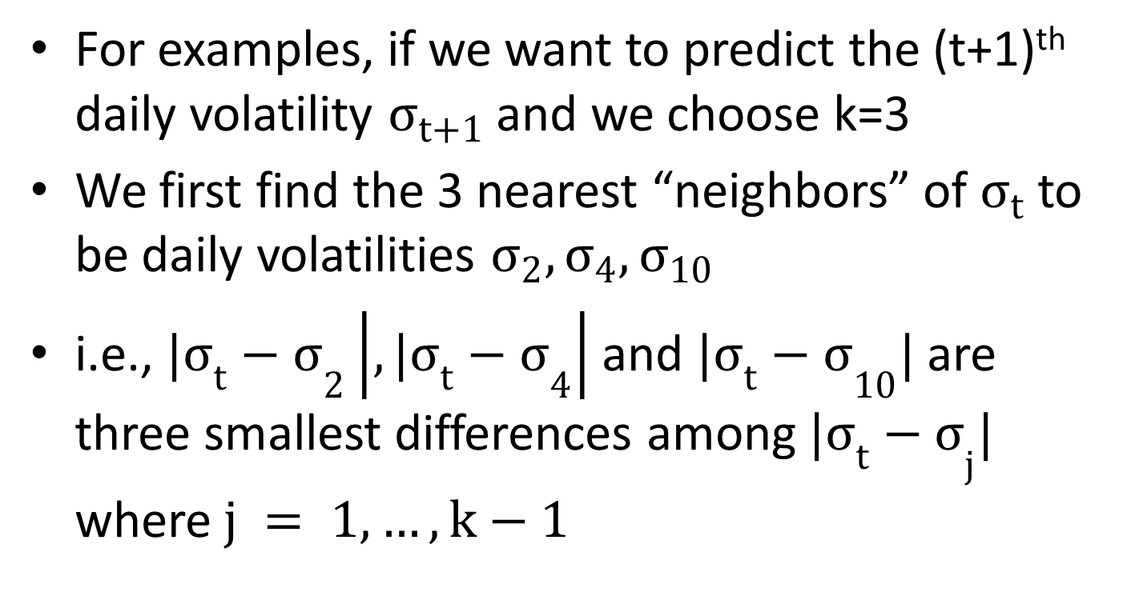
KNN
For examples, if we want to predict the (t+1)^{th} daily volatility $σ_{t+1}$ and we choose k=3
We first find the 3 nearest “neighbors” of $σ_{t}$to be daily volatilities $σ_{2},σ_{4},σ_{10}$
i.e., ${{|σ}_{t}−σ}_{2}\left|,{{|σ}_{t}−σ}_{4}\right|$ and ${{|σ}_{t}−σ}_{10}|$ are three smallest differences among ${{|σ}_{t}−σ}_{j}|$ where$j = 1, …, k−1$

Slide 24
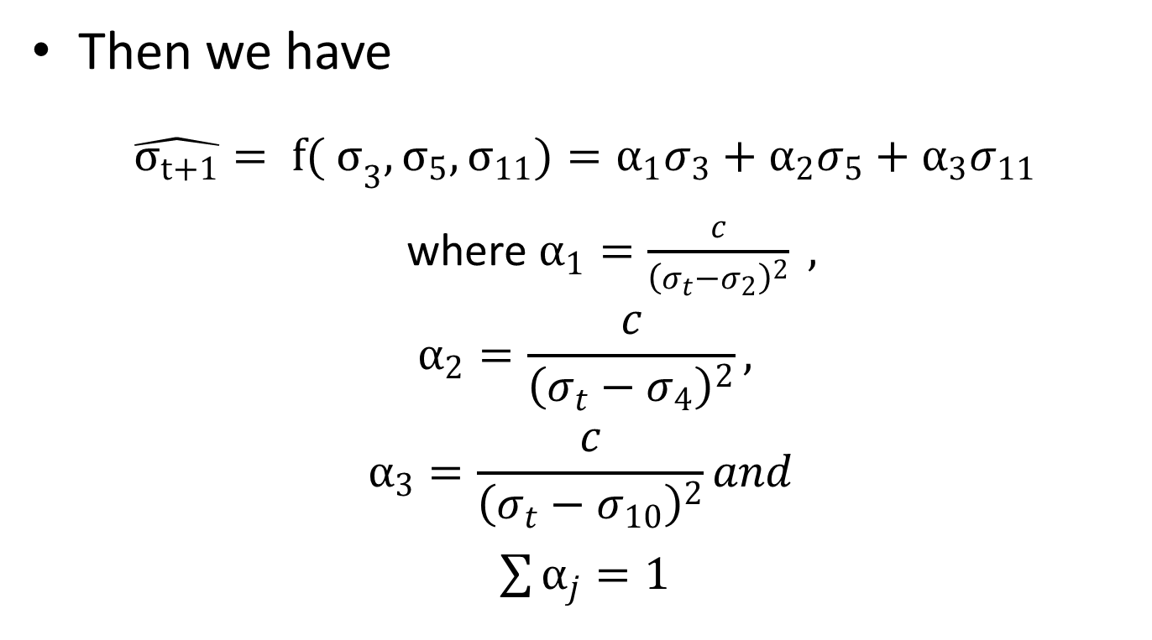
KNN
Then we have
$$\hat{σ_{t+1}}= {f( σ}_{3},σ_{5},σ_{11})=α_{1}σ_{3}+α_{2}σ_{5}+α_{3}σ_{11}$$
where $α_{1}=\frac{c}{{\left(σ_{t}−σ_{2}\right)}^{2}} ,$
$$α_{2}=\frac{c}{{\left(σ_{t}−σ_{4}\right)}^{2}},$$
$$α_{3}=\frac{c}{{\left(σ_{t}−σ_{10}\right)}^{2}}and$$
$\sum{α_{j}=1}$

Slide 25
Results Summary

Slide 26
Results Summary VAR

Slide 27
Results Summary - VAR
P=1
Results Summary of VAR

Slide 28
Results Summary - VAR
P=2
Results Summary of VAR

Slide 29
Results Summary - VAR
P=3
Results Summary of VAR

Slide 30
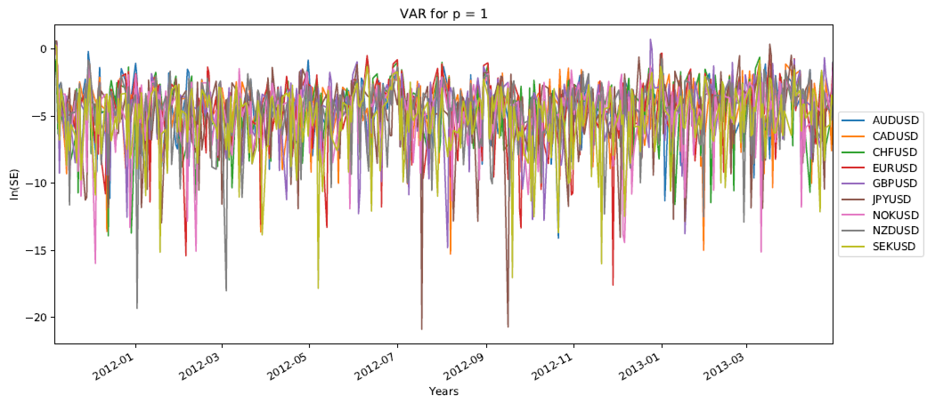
P=1
Results Summary of VAR

Slide 31
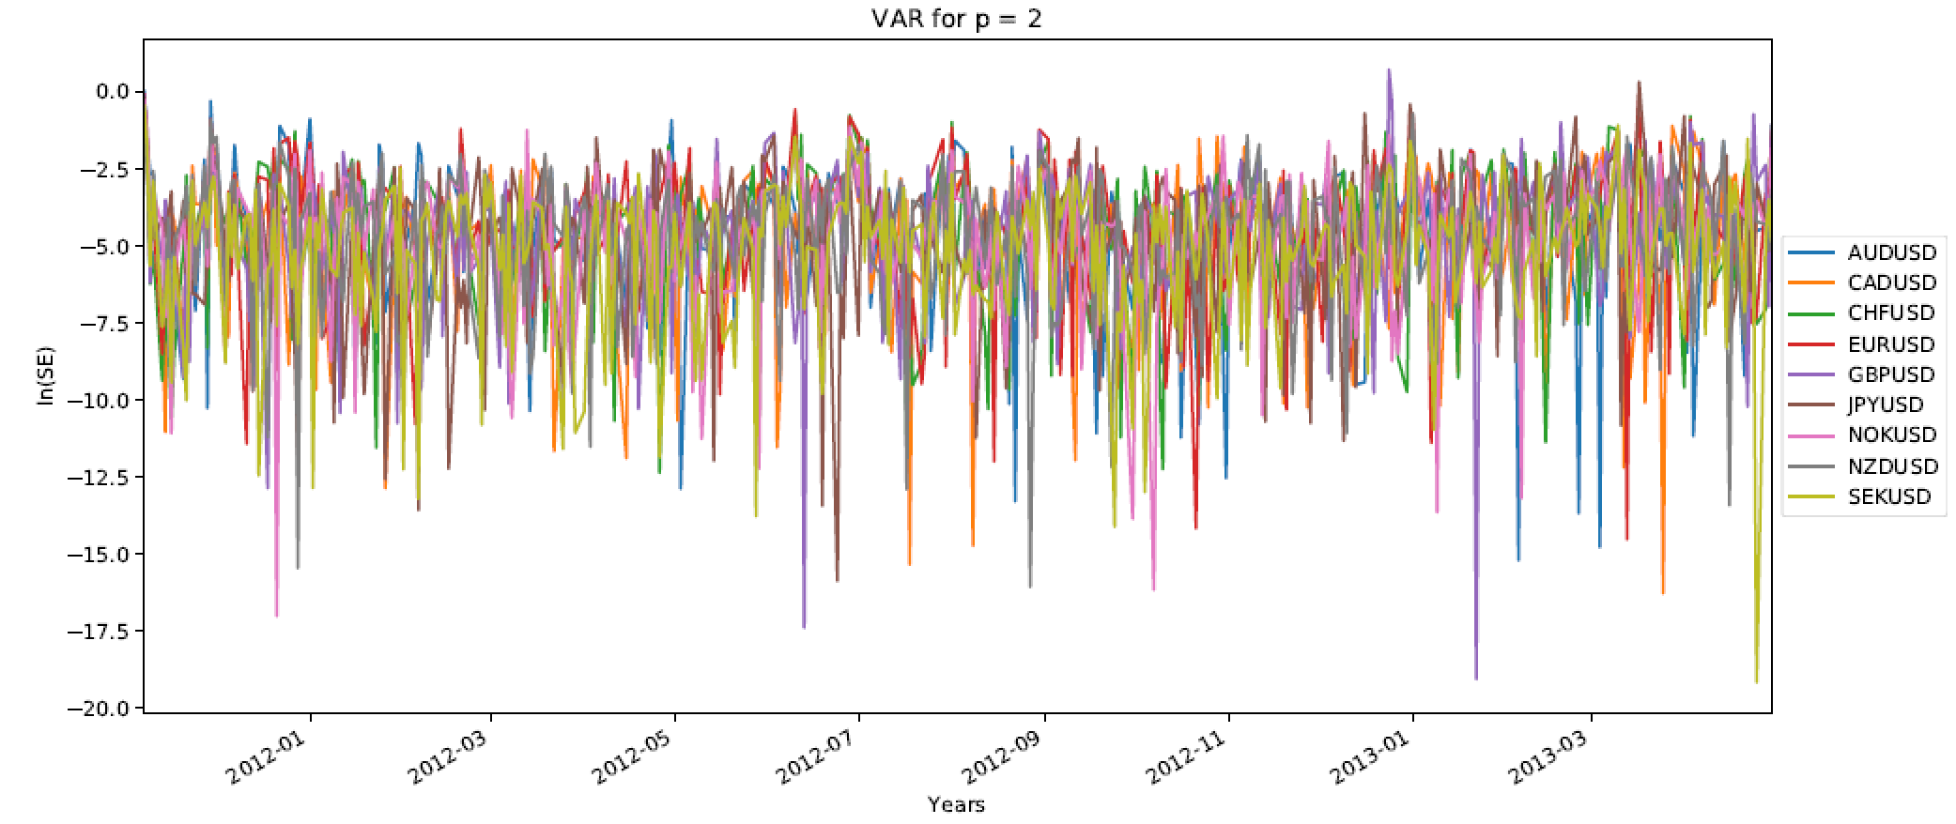
P=2
Results Summary of VAR

Slide 32
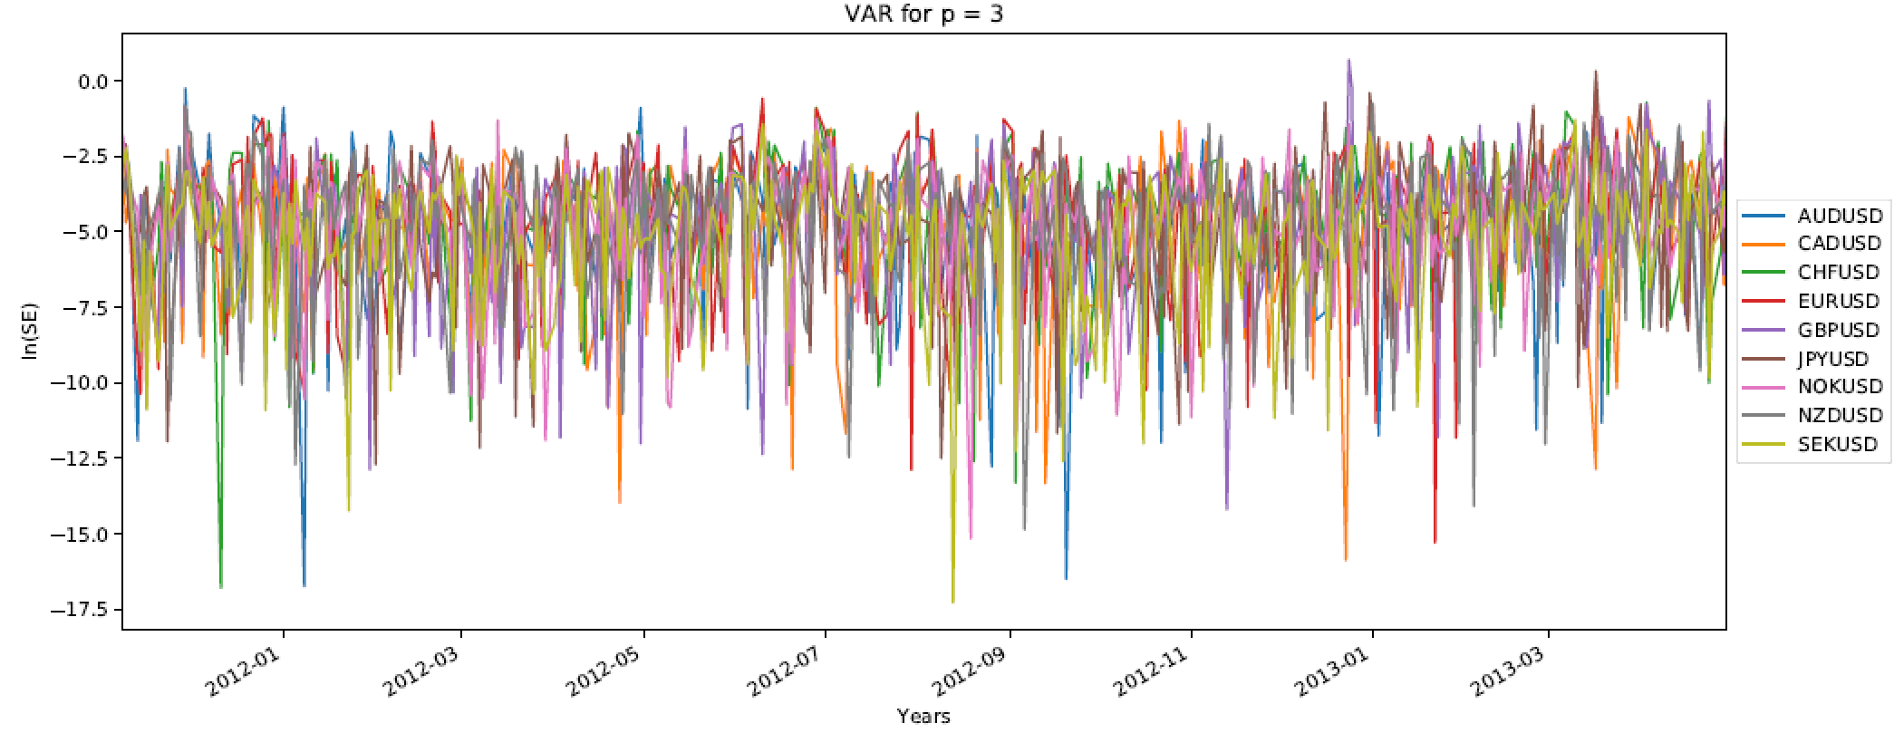
P=3
Results Summary of VAR

Slide 33
Results Summary LASSO

Slide 34
Results Summary LASSO P=1
Results Summary of LASSO

Slide 35
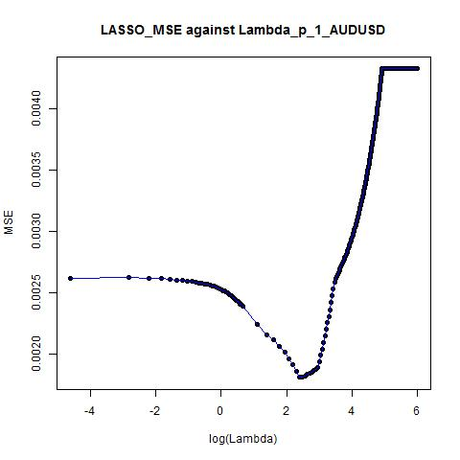
Optimal Lambda ≈ 11
Results Summary of LASSO

Slide 36
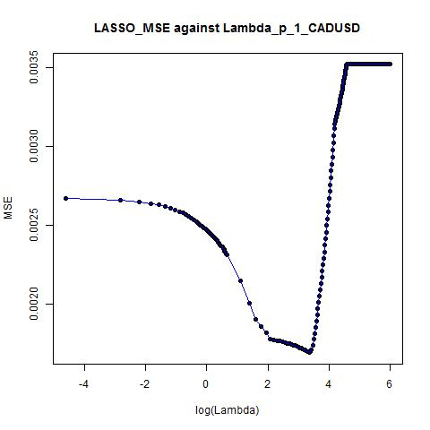
Optimal Lambda ≈ 29
Results Summary of LASSO

Slide 37
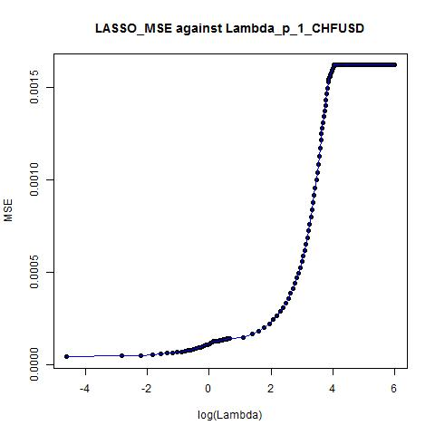
Optimal Lambda ≈ 0.01
Results Summary of LASSO

Slide 38
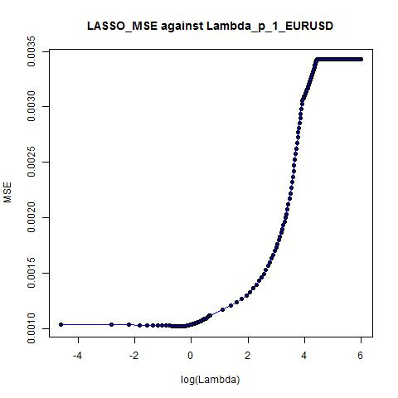
Optimal Lambda ≈ 0.71
Results Summary of LASSO

Slide 39
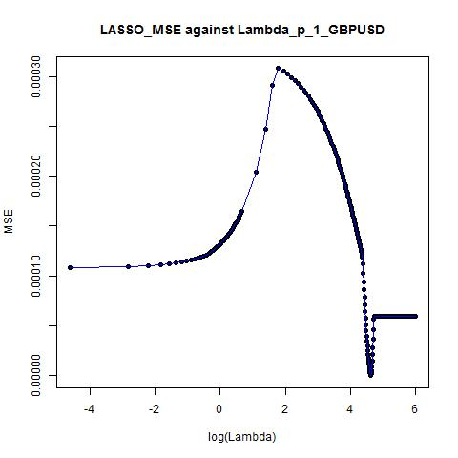
Optimal Lambda ≈ 102
Results Summary of LASSO

Slide 40
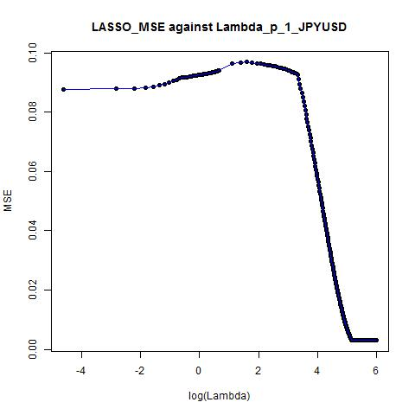
Optimal Lambda ≈ 174
Results Summary of LASSO

Slide 41
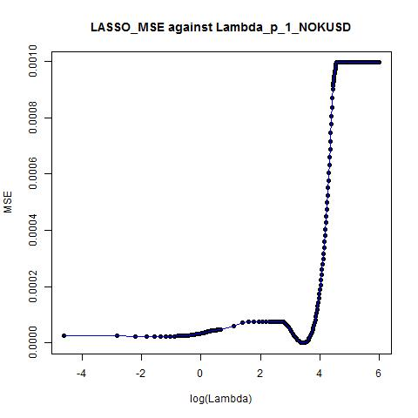
Optimal Lambda ≈ 31
Results Summary of LASSO

Slide 42
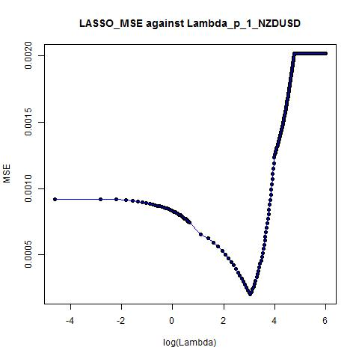
Optimal Lambda ≈ 21
Results Summary of LASSO

Slide 43
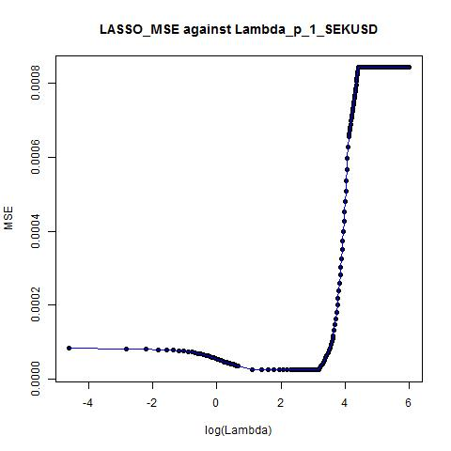
Optimal Lambda ≈ 3
Results Summary of LASSO

Slide 44
P=1
Results Summary of LASSO

Slide 45
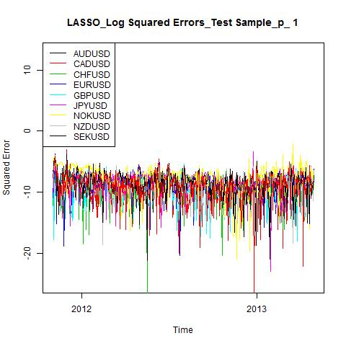
Combined SE Plots (log SE) for 9 Currencies Pairs
P = 1
Results Summary of LASSO

Slide 46
Results Summary LASSO P=2
Results Summary of LASSO

Slide 47
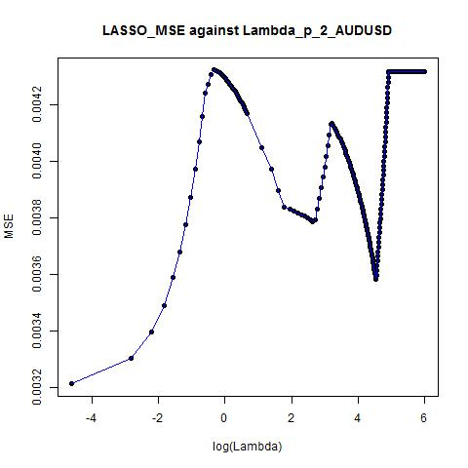
Optimal Lambda ≈ 0.01
Results Summary of LASSO

Slide 48
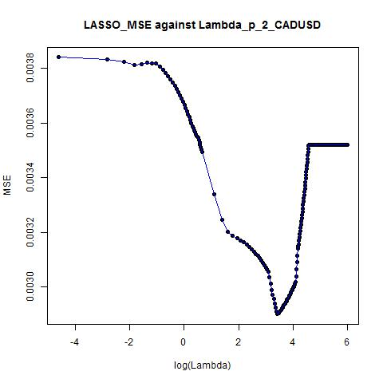
Optimal Lambda ≈ 31
Results Summary of LASSO

Slide 49
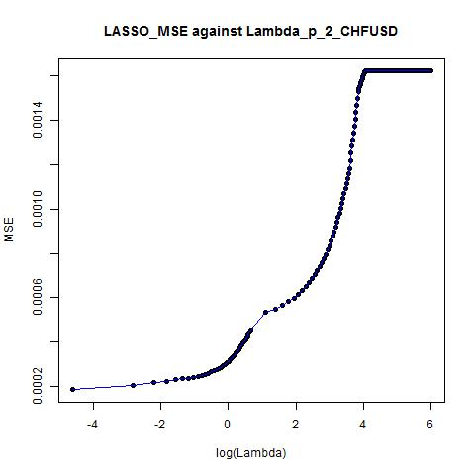
Optimal Lambda ≈ 0.01
Results Summary of LASSO

Slide 50
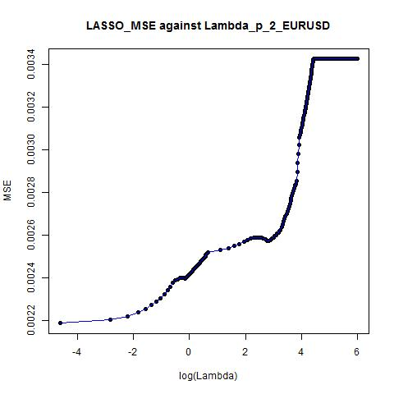
Optimal Lambda ≈ 0.71
Results Summary of LASSO

Slide 51
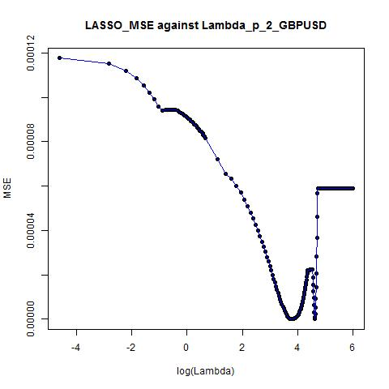
Optimal Lambda ≈ 102
Results Summary of LASSO

Slide 52
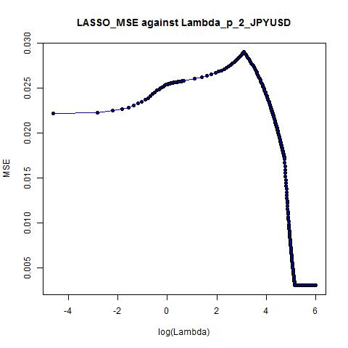
Optimal Lambda ≈ 174
Results Summary of LASSO

Slide 53
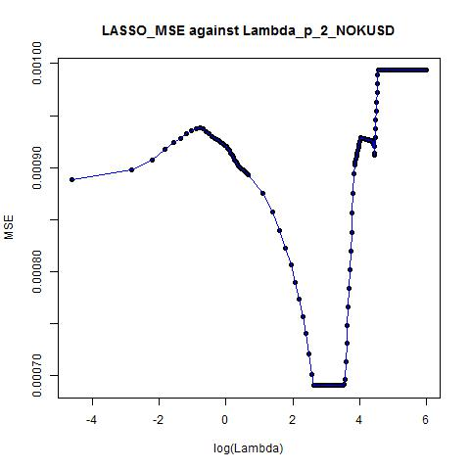
Optimal Lambda ≈ 31
Results Summary of LASSO

Slide 54
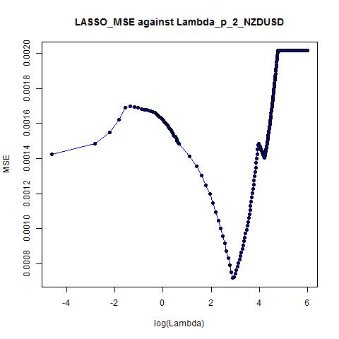
Optimal Lambda ≈ 21
Results Summary of LASSO

Slide 55
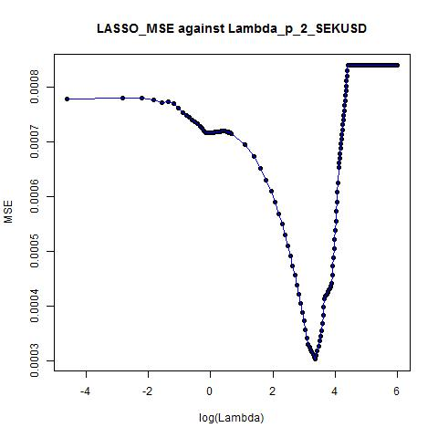
Optimal Lambda ≈ 3
Results Summary of LASSO

Slide 56
P=2
Results Summary of LASSO

Slide 57
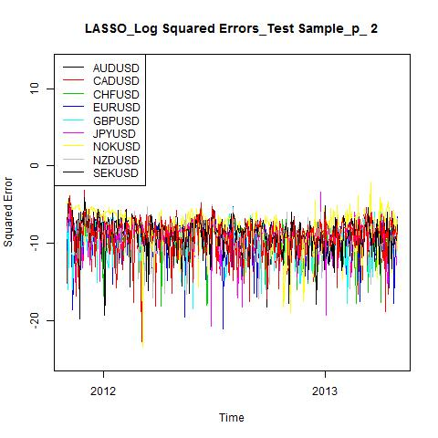
Combined SE Plots (log SE) for 9 Currencies Pairs
P = 2
Results Summary of LASSO

Slide 58
Results Summary LASSO P=3
Results Summary of LASSO

Slide 59
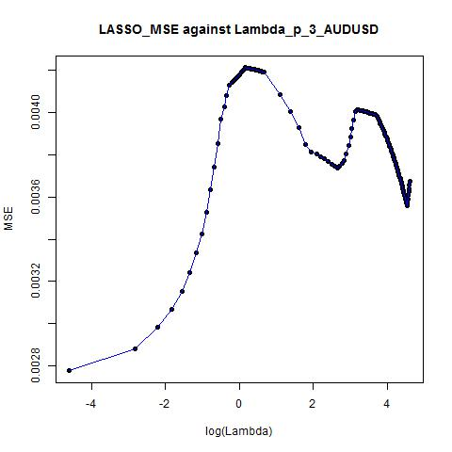
Optimal Lambda ≈ 0.01
Results Summary of LASSO

Slide 60
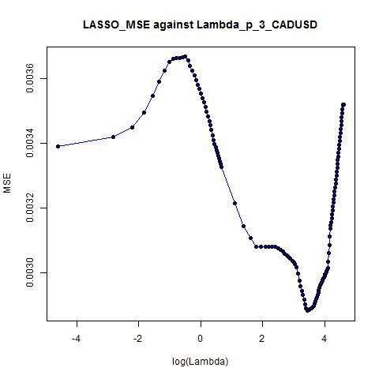
Optimal Lambda ≈ 31.00
Results Summary of LASSO

Slide 61
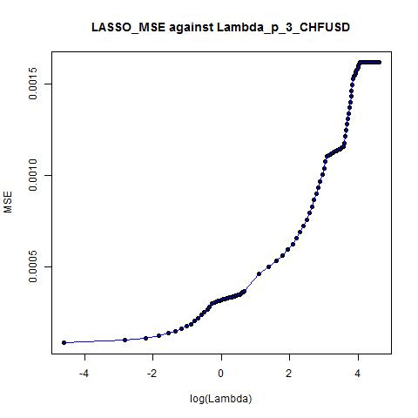
Optimal Lambda ≈ 0.01
Results Summary of LASSO

Slide 62
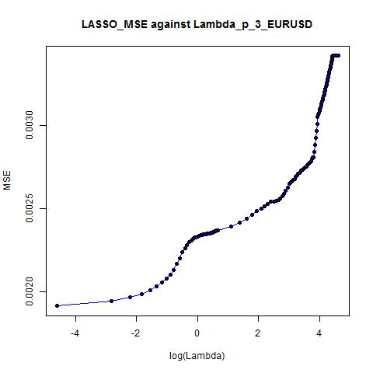
Optimal Lambda ≈ 0.01
Results Summary of LASSO

Slide 63
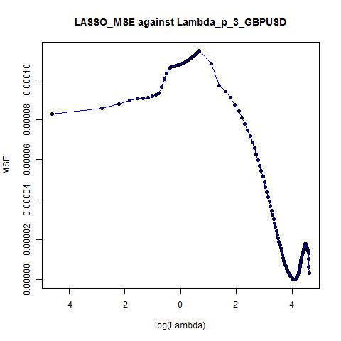
Optimal Lambda ≈ 59.00
Results Summary of LASSO

Slide 64
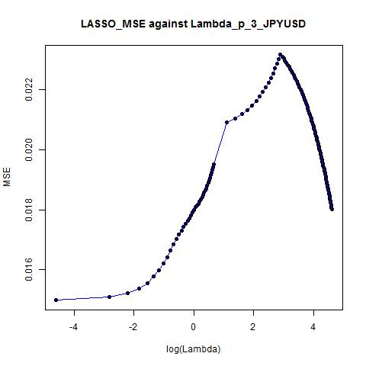
Optimal Lambda ≈ 0.01
Results Summary of LASSO

Slide 65
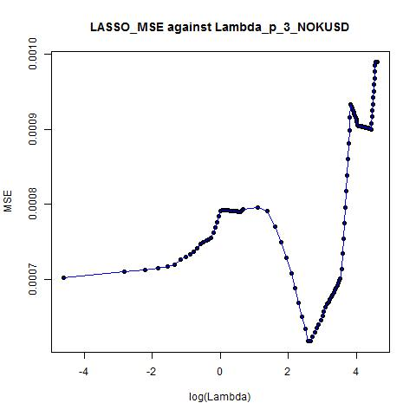
Optimal Lambda ≈ 13.00
Results Summary of LASSO

Slide 66
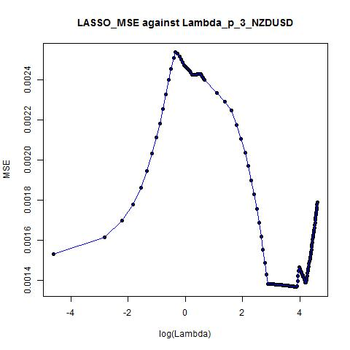
Optimal Lambda ≈ 48.00
Results Summary of LASSO

Slide 67
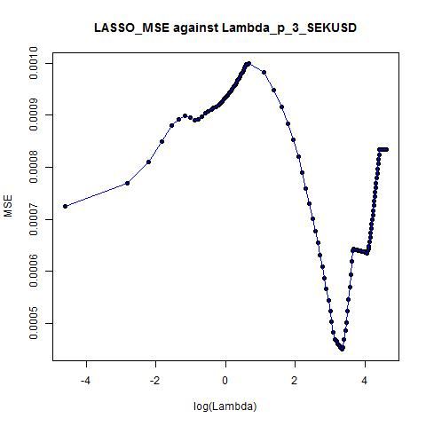
Optimal Lambda ≈ 28.00
Results Summary of LASSO

Slide 68
P=3
Results Summary of LASSO

Slide 69

Combined SE Plots (log SE) for 9 Currencies Pairs
P = 3
Results Summary of LASSO

Slide 70
Results Summary Ordered Lasso

Slide 71
Results Summary - Ordered LASSO
For the results summarized below, please note that we used two sets of lambda values
For the plot on the left (x axis is Lambda) and the MSE/QL table on the left, the optimal lambda’s are obtained using
Lambda Values=c(seq(0.01,2,0.01),c(3,400,1))
For the plot on the right (x axis is log(Lambda)) and the MSE/QL table on the right, the optimal lambda’s are obtained using
Lambda Values=c(exp(seq(-10,0,0.05)),seq(1.01,2,0.01),seq(3,400,1))
According to the MSE, QL and SE plots in the test sample, the optimal lambda obtained from the second set of lambda values which is finer generally produced better prediction performance.
Results Summary of Ordered LASSO

Slide 72
Results Summary Ordered LASSO P=1
Results Summary of Ordered LASSO

Slide 73


Optimal Lambda ≈ 0.01
Optimal Lambda ≈ 0.0000454
Results Summary of Ordered LASSO

Slide 74


Optimal Lambda ≈ 1.11
Optimal Lambda ≈ 1.11
Results Summary of Ordered LASSO

Slide 75


Optimal Lambda ≈ 0.07
Optimal Lambda ≈ 0.0672055
Results Summary of Ordered LASSO

Slide 76


Optimal Lambda ≈ 1.38
Optimal Lambda ≈ 0.0000454
Results Summary of Ordered LASSO

Slide 77


Optimal Lambda ≈ 132
Optimal Lambda ≈ 132
Results Summary of Ordered LASSO

Slide 78


Optimal Lambda ≈ 400
Optimal Lambda ≈ 400
Results Summary of Ordered LASSO

Slide 79


Optimal Lambda ≈ 20
Optimal Lambda ≈ 20
Results Summary of Ordered LASSO

Slide 80


Optimal Lambda ≈ 0.01
Optimal Lambda ≈ 0.0000454
Results Summary of Ordered LASSO

Slide 81


Optimal Lambda ≈ 23
Optimal Lambda ≈ 23
Results Summary of Ordered LASSO

Slide 82
P=1
Results Summary of Ordered LASSO

Slide 83


Optimal Lambda ≈ 0.01
Optimal Lambda ≈ 0.0000454
Results Summary of Ordered LASSO

Slide 84


Optimal Lambda ≈ 1.11
Optimal Lambda ≈ 1.11
Results Summary of Ordered LASSO

Slide 85


Optimal Lambda ≈ 0.07
Optimal Lambda ≈ 0.0672055
Results Summary of Ordered LASSO

Slide 86


Optimal Lambda ≈ 1.38
Optimal Lambda ≈ 0.0000454
Results Summary of Ordered LASSO

Slide 87


Optimal Lambda ≈ 132
Optimal Lambda ≈ 132
Results Summary of Ordered LASSO

Slide 88


Optimal Lambda ≈ 400
Optimal Lambda ≈ 400
Results Summary of Ordered LASSO

Slide 89


Optimal Lambda ≈ 20
Optimal Lambda ≈ 20
Results Summary of Ordered LASSO

Slide 90


Optimal Lambda ≈ 0.01
Optimal Lambda ≈ 0.0000454
Results Summary of Ordered LASSO

Slide 91


Optimal Lambda ≈ 23
Optimal Lambda ≈ 23
Results Summary of Ordered LASSO

Slide 92


Combined SE Plots (log SE) for 9 Currencies Pairs
P = 1
Results Summary of Ordered LASSO

Slide 93
Results Summary Ordered LASSO P=2
Results Summary of Ordered LASSO

Slide 94


Optimal Lambda ≈ 0.01
Optimal Lambda ≈ 0.0000454
Results Summary of Ordered LASSO

Slide 95


Optimal Lambda ≈ 206
Optimal Lambda ≈ 0.0223708
Results Summary of Ordered LASSO

Slide 96


Optimal Lambda ≈ 0.48
Optimal Lambda ≈ 0.0000454
Results Summary of Ordered LASSO

Slide 97


Optimal Lambda ≈ 0.92
Optimal Lambda ≈ 0.9512294
Results Summary of Ordered LASSO

Slide 98


Optimal Lambda ≈ 0.03
Optimal Lambda ≈ 0.0287246
Results Summary of Ordered LASSO

Slide 99


Optimal Lambda ≈ 0.08
Optimal Lambda ≈ 0.0780817
Results Summary of Ordered LASSO

Slide 100


Optimal Lambda ≈ 0.03
Optimal Lambda ≈ 0.0301974
Results Summary of Ordered LASSO

Slide 101


Optimal Lambda ≈ 0.01
Optimal Lambda ≈ 0.0000454
Results Summary of Ordered LASSO

Slide 102


Optimal Lambda ≈ 0.01
Optimal Lambda ≈ 0.0000454
Results Summary of Ordered LASSO

Slide 103
P=2
Results Summary of Ordered LASSO

Slide 104


Optimal Lambda ≈ 0.01
Optimal Lambda ≈ 0.0000454
Results Summary of Ordered LASSO

Slide 105


Optimal Lambda ≈ 206
Optimal Lambda ≈ 0.0223708
Results Summary of Ordered LASSO

Slide 106


Optimal Lambda ≈ 0.48
Optimal Lambda ≈ 0.0000454
Results Summary of Ordered LASSO

Slide 107


Optimal Lambda ≈ 0.92
Optimal Lambda ≈ 0.9512294
Results Summary of Ordered LASSO

Slide 108

Optimal Lambda ≈ 0.03
Optimal Lambda ≈ 0.0287246
Results Summary of Ordered LASSO

Slide 109


Optimal Lambda ≈ 0.08
Optimal Lambda ≈ 0.0780817
Results Summary of Ordered LASSO

Slide 110


Optimal Lambda ≈ 0.03
Optimal Lambda ≈ 0.0301974
Results Summary of Ordered LASSO

Slide 111


Optimal Lambda ≈ 0.01
Optimal Lambda ≈ 0.0000454
Results Summary of Ordered LASSO

Slide 112


Optimal Lambda ≈ 0.01
Optimal Lambda ≈ 0.0000454
Results Summary of Ordered LASSO

Slide 113


Combined SE Plots (log SE) for 9 Currencies Pairs
P = 2
Results Summary of Ordered LASSO

Slide 114
Results Summary Ordered LASSO P=3
Results Summary of Ordered LASSO

Slide 115


Optimal Lambda ≈ 0.01
Optimal Lambda ≈ 0.006097
Results Summary of Ordered LASSO

Slide 116


Optimal Lambda ≈ 0.03
Optimal Lambda ≈ 0.023518
Results Summary of Ordered LASSO

Slide 117


Optimal Lambda ≈ 0.03
Optimal Lambda ≈ 0.022371
Results Summary of Ordered LASSO

Slide 118


Optimal Lambda ≈ 0.04
Optimal Lambda ≈ 0.035084
Results Summary of Ordered LASSO

Slide 119


Optimal Lambda ≈ 178
Optimal Lambda ≈ 0.012277
Results Summary of Ordered LASSO

Slide 120


Optimal Lambda ≈ 0.43
Optimal Lambda ≈ 0.070651
Results Summary of Ordered LASSO

Slide 121


Optimal Lambda ≈ 0.08
Optimal Lambda ≈ 0.074274
Results Summary of Ordered LASSO

Slide 122


Optimal Lambda ≈ 0.01
Optimal Lambda ≈ 0.006097
Results Summary of Ordered LASSO

Slide 123


Optimal Lambda ≈ 0.01
Optimal Lambda ≈ 0.005517
Results Summary of Ordered LASSO

Slide 124
P=3
Results Summary of Ordered LASSO

Slide 125


Optimal Lambda ≈ 0.01
Optimal Lambda ≈ 0.006097
Results Summary of Ordered LASSO

Slide 126


Optimal Lambda ≈ 0.03
Optimal Lambda ≈ 0.023518
Results Summary of Ordered LASSO

Slide 127


Optimal Lambda ≈ 0.03
Optimal Lambda ≈ 0.022371
Results Summary of Ordered LASSO

Slide 128


Optimal Lambda ≈ 0.04
Optimal Lambda ≈ 0.035084
Results Summary of Ordered LASSO

Slide 129


Optimal Lambda ≈ 178
Optimal Lambda ≈ 0.012277
Results Summary of Ordered LASSO

Slide 130


Optimal Lambda ≈ 0.43
Optimal Lambda ≈ 0.070651
Results Summary of Ordered LASSO

Slide 131


Optimal Lambda ≈ 0.08
Optimal Lambda ≈ 0.074274
Results Summary of Ordered LASSO

Slide 132


Optimal Lambda ≈ 0.01
Optimal Lambda ≈ 0.006097
Results Summary of Ordered LASSO

Slide 133


Optimal Lambda ≈ 0.01
Optimal Lambda ≈ 0.005517
Results Summary of Ordered LASSO

Slide 134


Combined SE Plots (log SE) for 9 Currencies Pairs
P = 3
Results Summary of Ordered LASSO

Slide 135
Results Summary KNN
From the MSE – Lambda plots below,
the optimal k* giving the smallest MSE seems to be 20 for all the currency pairs;
the optimal k* which is approximately the “elbow” of MSE - lambda plots seems to be 10 for all the currency pairs.
We used k* for 10 and 20 in the test sample.

Slide 136

Results Summary of KNN

Slide 137


Results Summary of KNN

Slide 138

Results Summary of KNN

Slide 139

Results Summary of KNN

Slide 140


Results Summary of KNN

Slide 141

Results Summary of KNN

Slide 142

Results Summary of KNN

Slide 143

Results Summary of KNN

Slide 144

Results Summary of KNN

Slide 145
k* = 20 (k* producing the smallest MSE)
Results Summary of KNN

Slide 146
k* = 10 (the “elbow” of the MSE Lambda Plot)
Results Summary of KNN

Slide 147

k* = 20
Results Summary of KNN

Slide 148

k* = 10
Results Summary of KNN

